Slide 1
GENERAL COMPUTER CONTROLS
Mwamba Ally jingu: FCPA; PhD

Slide 2
GENERAL COMPUTER CONTROLS
The general control has six controls: Organizational; Operational; terminal; environmental; file and software controls. General (installation) Controls are applied at the level of the computer Centre. They ensure that the computer Centre is able to process the work received in spite of risks from natural disasters (e.g., floods) or from malicious or accidental human beings

Slide 3
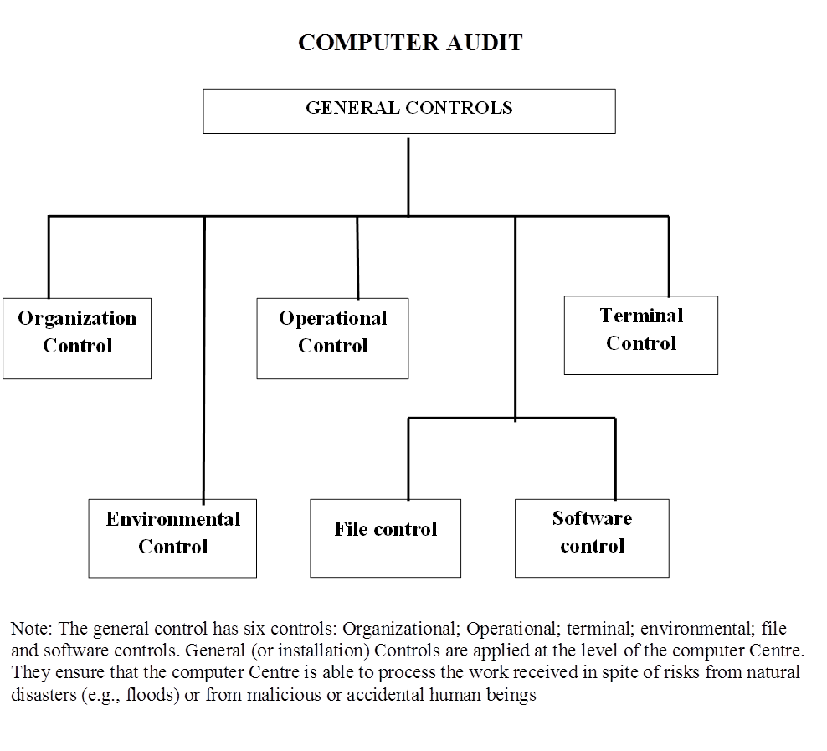

Slide 4
Environmental Controls
Those dealing with the risk of fire, flood, vandalism, sabotage, theft and the adequacy of insurance cover
Audit Objectives
To ensure that there is adequate protection for:
the staff, computer equipment and environment,
data and documentation against accidental or deliberate threat,

Slide 5
Areas of Loss
Direct financial loss; Indirect financial loss
Areas of Control (Potential Hazards)
(i) Accidental damage from:-
Natural disasters such as flood and fire, location disasters caused by the proximity of neighbouring risk areas
Disruption of essential services, e.g., power failure
(ii) Deliberate damage:-
Vandalism and sabotage; Theft; Fraud and Unauthorised uses of facilities

Slide 6
Key Questions on Environmental Controls
1. Are there adequate controls over physical access to the computer and the related equipment? Consider
The characteristics of the building housing the computer
The strength of the wall around the secure area
Door locking and unlocking mechanisms
Use of security passes.
Presence of the functions of the security officer
Written log of visitor
Office cleaning and maintenance arrangements
Inspection of cases and bags coming into or going out of the building
Unauthorised accesses detection

Slide 7
2. Are there adequate arrangements to reduce the risk of a major disaster? Consider
Location of the building housing the computer
Location of the computer within the building
The structure of the computer room and the fire resistance of the fixtures and fittings.
No smoking rules
Tidiness of the computer area.
Cleaning of the computer room especially the cavity floor
Smoke detection and alarm systems
Fire alarm system
Location of storage tanks and water pipes
Necessity for flood warning systems

Slide 8
3. Are there adequate arrangements in the event of major disaster? Consider
Training of staff in the event of a disaster.
Essential services: Standby electricity generators; alternator
Gas flooding systems for fire extinguishing
Maintenance agreements
Standby/Recovery arrangements
Hardware
Standby agreements
Testing of the standby and recovery arrangements
Security of the standby site
Provision to cope with the prolonged of computing service
Software
Back-up procedures; Data files; Programmes; Documentation; Systems software

Slide 9
File and Software Controls
Those governing the access to and protection of all physical magnetic files and to the data contained on them both by way of software controls and physical controls
Audit objectives:
To ensure that the controls and procedures adequately safeguard files against:
loss, misuse, theft, damage,
unauthorised disclosure, and accidental corruption, and
provide for the recovery of information held on files.

Slide 10
The auditor needs to cover the following aspects:-
Physical file custody: The auditor should identify:
the various types of media used,
where it is kept and
who is responsible for its custody and maintenance
Software and access control: The auditor should identify:
the software available in the installation and also,
check on the access restrictions, to ensure that files are safeguarded from unauthorised interference

Slide 11
Back-up and archive routines:
The accidental and deliberate loss or theft of an organisation’s data:
through hardware, software, data and operator errors may have negative consequences.
The auditor should therefore check to see that there are back-up copies kept in different (remote) and secure locations that are tested periodically, on both the main and back-up sites
Programme change
The audit objective is to ensure that all production programmes are:
authorised, and any amendments thereto are authorised, tested, recorded, and checked

Slide 12
Key Question on File and software controls
1. Are there adequate controls over physical custody of files? Consider
Responsibilities and duties of data control personnel
File librarian facilities
, records, logs and registers of file custody
Physical storage facilities
File retention criteria

Slide 13
2. Are there controls to prevent unauthorised amendments to data files? Consider
Authorisation of jobs prior to processing.
Records of changes and procedures for ensuring completeness and accuracy of the record
Supervisory review of record of changes to detect unauthorised changes.
Password protection and procedures for recording and investigating unauthorised access attempts
Physical protection of data files
Restricted use of utility programs
Segregation of duties: database; administration; programing; operations
Training and Supervision

Slide 14
3. Are there controls to detect unauthorised changes to programs? Consider for program maintenance
Authorisation of jobs prior to processing
Record of program changes by system/librarian software
Supervisory review of record of program changes to detect unauthorised changes:
Authority of review
Frequency of review
Procedures for follow-up of unauthorised changes
Password protection of programs and procedure
Physical protection of production programs stored off-line
Comparison of production programs to controlled copies
Segregation of duties: Programming; Authorisation; Operations; Training and Supervision

Slide 15
File and Software Controls Continued
3. Are there controls to detect unauthorised changes to programs? Consider for program execution
Access restriction to program documentation
Procedures to prevent access to load modules during executions
Restricted access to computer and remote terminals
Review if job accounting reports, investigating unusual delays
Segregation of duties: programming; operations
Training
Supervision

Slide 16
OPERATIONAL CONTROLS
Audit Objectives;
To ensure that operational controls provide the discipline and uniformity necessary to cover all aspects of the day-to-day running of production systems, from the reception of prime data through the data conversion and processing to distribution of final output, That is,
To assess the extent to which the operating system is used to control access to the machine and an appropriate level of access to the individual files and group of files
To assess the adequacy of the operating system mechanisms for dumping and restoring files for security purposes and as a basis for off-site standby

Slide 17
To appraise whether the operating system provide a means for gathering and recording useful information on all jobs run which can then be used for a variety of management purposes, ranging from job accounting to control.
To appraise whether installation management, technical staff and operators implement and tune the system and monitor the machine resources in order to maximise job output, providing an equitable and efficient service to users.
To consider the processing overhead which the operating system imposes.

Slide 18
Auditing procedures and techniques
The auditor must establish whether the structure and control techniques are adequate regarding:
Receipt and conversion of data:- Authenticity of prime data; Movements of documents; Verification and validation of data
Control of access files:- User structure; Catalogue soft ware; User identity; Passwords; Permissions; Alien file; Development and production program libraries
Control of data during processing:- Job scheduling (long and short term)

Slide 19
Key Questions – Operational controls
Are there controls to prevent or detect errors during programme execution? Consider:
Operational controls included in systems software
Maintenance of program version numbers
Checking of program version numbers
Label checking
Operations manual detailing procedures for set-up and execution
Details of job requirements; Job scheduling
Distribution of paper; Distribution of magnetic output
Training; Supervision

Slide 20
Are the arrangements for the receipt and conversion of data adequate?
Consider
Responsibility for receipt of data
Recording of receipt of data
Confirming the authority for processing of data
Control over movement of data within computer division
Verification and validation of data

Slide 21
TERMINAL CONTROLS
Those governing the access to and processing performed by all terminals connected to the computer installation
Audit Objectives:
To ensure that all terminal activity is properly authorised, inaccurate and inefficient processing is minimised
The auditor should review the following:
Physical restrictions on access:
Authorisation to use terminal
Suitability of location of terminals
Provision of locks and identification devices
Methods of connection to mainframe

Slide 22
Software restrictions on access:
Identify the terminals
Identify the user of the terminal
Identify the file required
Time restriction
Encryption
Facilities for recording terminal activity
Recording terminal processing to provide a historical record. Copies of selected terminal job initiated may be routed to the mainframe printer for collection and inspection by computer manager and audit

Slide 23
Key Questions – Terminal controls
Are the physical restrictions on terminal activity adequate? Consider
Activity to use terminal
Responsibility for terminal security
Location of terminal (privacy)
Use of physical locking devices
Method of connection to mainframe (use of substitute connections)
Security of files held at remote sites
Characteristics of terminal usage.

Slide 24
2. Are the software restrictions on terminal activity adequate?
Consider
Ability of the software to identify each terminal
Ability of the software to identify user of the terminal
Control over design, issue and use of user’s identification codes
Control over access to data and programs for each:
Terminal
User
Time restrictions on users
3. Are there adequate records of terminal proceedings? Consider
Clerical records of activity relating to each terminal
Software records of above
Supervisory review of above records

Slide 25
ORGANISATIONAL CONTROLS
Those dealing with the organisation of the responsibilities of all involved in the computer process and the standards established for their efficient working
Audit objectives:
To ensure that the procedure adopted within the computer departments provide a good separation of the various disciplines within the department together with the presence of comprehensive written standards
The auditor should satisfy himself or herself of the following:
Separation of duties:-
Preparation of and compliance with job description
Establishment of chain command
Adequate considerations given to the location of staff
Standards:-
Written standards adopted and adhered to

Slide 26
Key questions on Organisational Controls
1. Is the overall organisation structure conducive to adequate internal controls? Consider:
Is the accounting function segregated from the operating and asset custodianship functions
Is there adequate division of duties within the accounting function
2. Do employee appear competent in arrears critical to internal controls? Consider
Job description define the scope and key tasks of each post
Procedure manuals document all systems
Existence and implementation of a staff development programme
Existence of personnel specifications and adequate screening before hiring
Prior years’ experience of errors which may have an impact on view of competence

Slide 27
2. Is the computer department organisation structure conducive to adequate internal control? Consider:
Clear reporting and accountability relationship
Separation of computer department from users
Separation of key functions within the computer departments
Systems design and development
Support and maintenance
Operations
Media storage
Data preparation
Control section
Provision for supervision and quality control checks

Slide 28
Thank You for Your Attention
Questions and Answers

Slide 29
Master file controls
The purpose of master file controls is to ensure the ongoing integrity of the standing data contained in the master files. It is vitally important that stringent ‘security’ controls should be exercised over all master files. These include:
―Appropriate use of passwords, to restrict access to master file data
―The establishment of adequate procedures over the amendment of data,
―Comprising appropriate segregation of duties, and authority to amend being restricted to appropriate responsible individuals
– Regular checking of master file data to authorised data, by an independent responsible official
―Processing controls over the updating of master files, including the use of record counts and control totals

